Slide 1


IV SEMESTER DESIGN THINKING LAB (18CS47)
Go, change the world
Go, change the world
RV College of
Engineering
Department of Computer Science and Engineering
R V College of Engineering, Bengaluru.

Slide 2

RECOGNIZING THE LEARNING GAP IN ONLINE EDUCATION USING MULTIMODAL AFFECT RECOGNITION
Go, change the world
STUDENT NAME | USN
Akshita Gupta | 1RV19CS013
Pooja Rajesh | 1RV19CS113
Praneeta Immadisetty | 1RV19CS117
Theme: 5 – Conservation Agriculture, Health care, and Quality Education
Mentor Name & Designation: Dr. Prapulla S B (Assistant Professor) and Dr. Soumya A (Associate Professor)

Slide 3






THEME IDENTIFIED
Go, change the world
Global Pandemic
Video conferencing to aid education
Interactive method
Distractions at home
Feedback to teachers
Change online education as we know it

Slide 4




Customer Groups
Go, change the world
Educational Field
Student
Teacher
MOOCs

Slide 5
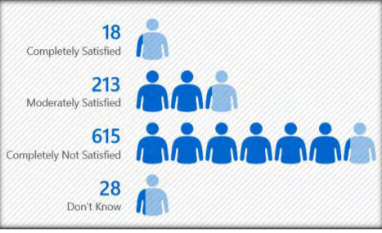
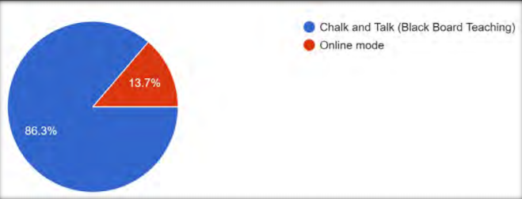
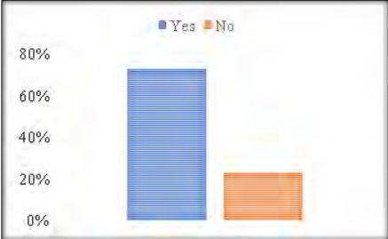
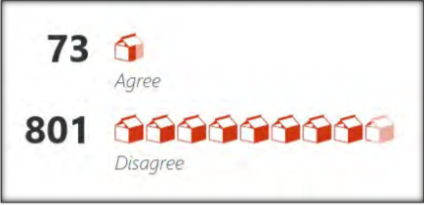
EXISTING STATISTICS AND FIGURES
Go, change the world
Stake holders’ response for mode of students
Participants satisfaction on online class
Responses for Effectiveness of labs teaching in online
Responses for individual growth affected because of lockdown
* Source: Article from Pedagogical Research (PEDRE)

Slide 6

Empathy Phase
PHASE 1
Go, change the world

Slide 7





Stages of the Empathy Phase
Go, change the world
SURVEY FORM
QUESTIONNAIRE
INTERVIEWS
EMPATHY MAPS
CUSTOMER JOURNEY MAP

Slide 8

Survey
Go, change the world

Slide 9


STAKEHOLDERS
Go, change the world
ENGINEERING STUDENTS
ENGINEERING PROFESSORS

Slide 10
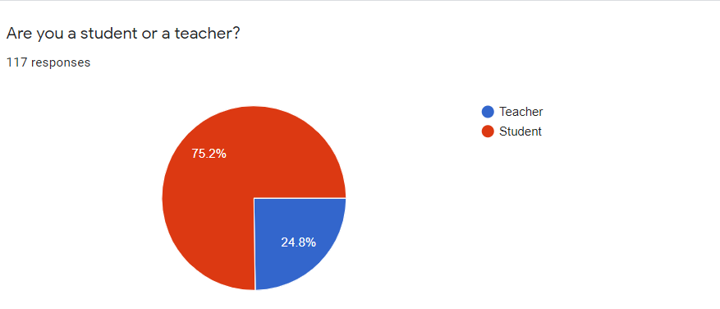
RATIO OF STAKEHOLDERS
Go, change the world
https://forms.gle/kaPkqEGj7gbnMpXX9
https://docs.google.com/forms/d/10XJKgFck4U_s-yubMYrMh16eDr9WCGiW1aQGDUmPckM/edit?ts=60815b09&gxids=7628#responses

Slide 11
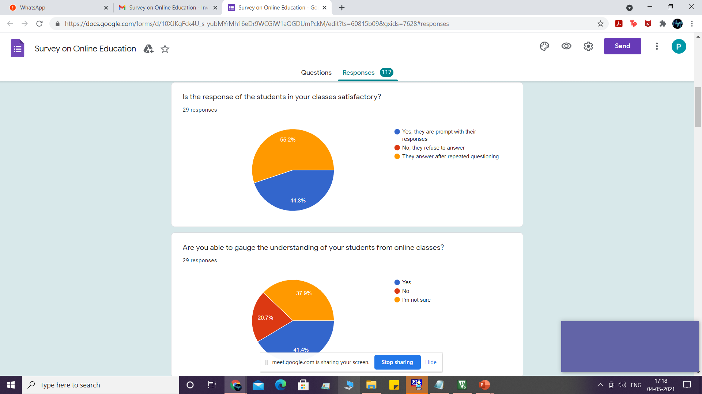
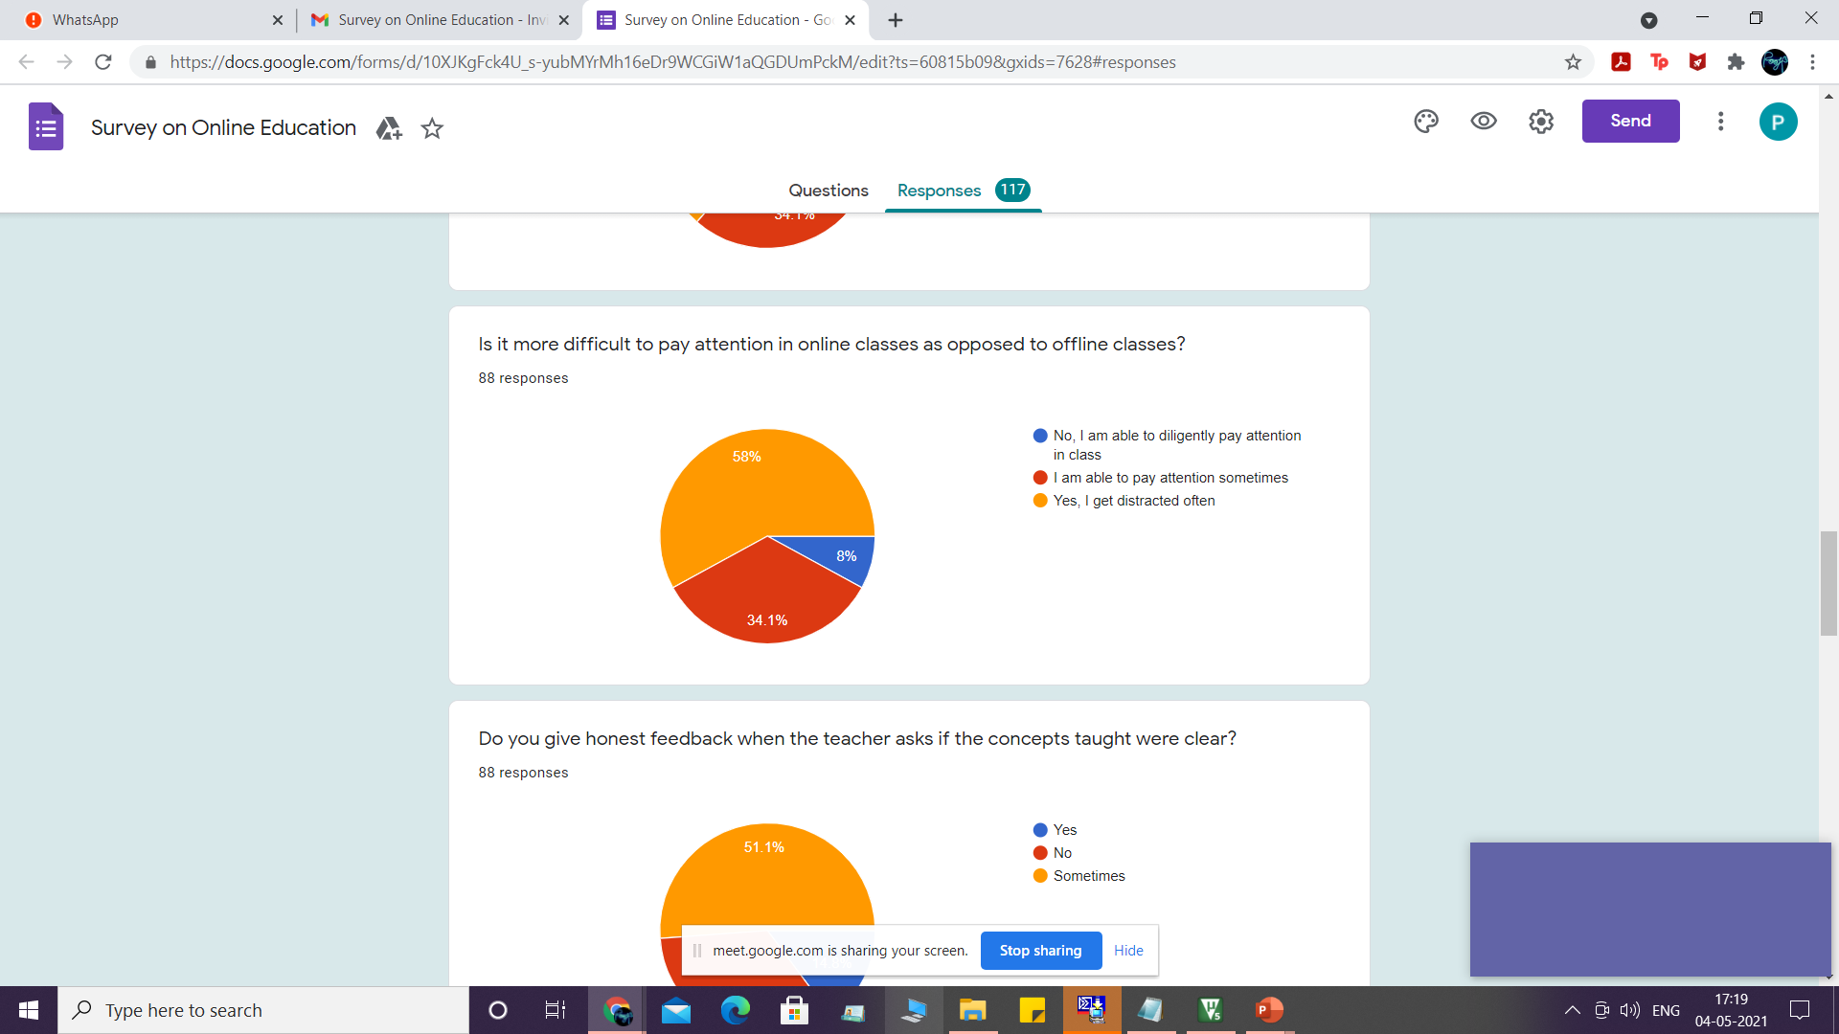
TEACHER VS STUDENT RESPONSES
Go, change the world

Slide 12
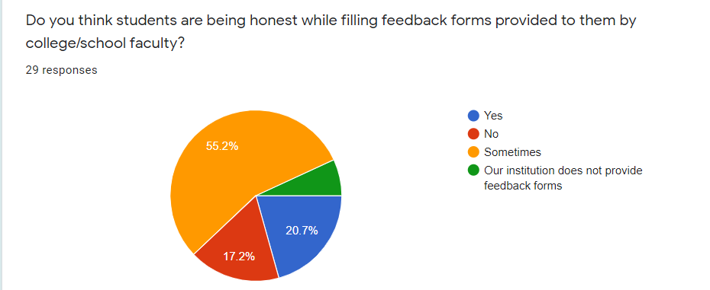
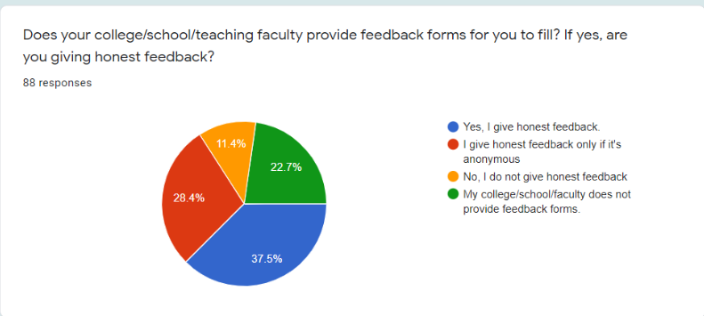
TEACHER VS STUDENT RESPONSES
Go, change the world

Slide 13
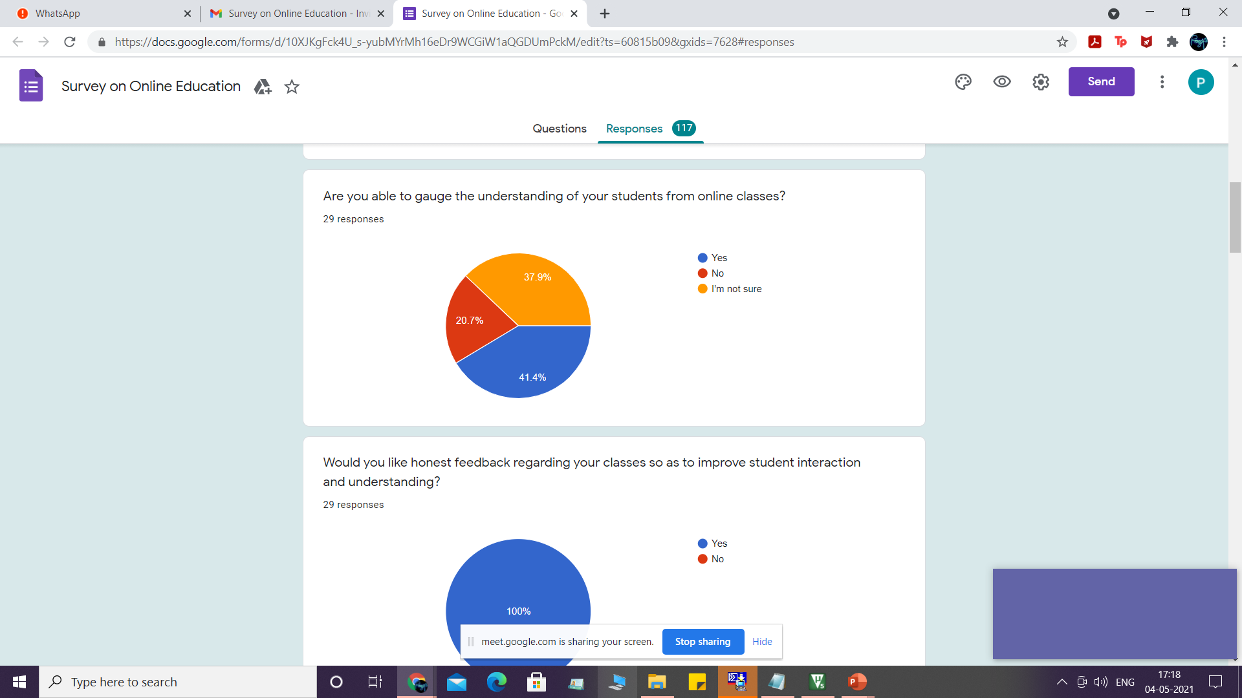
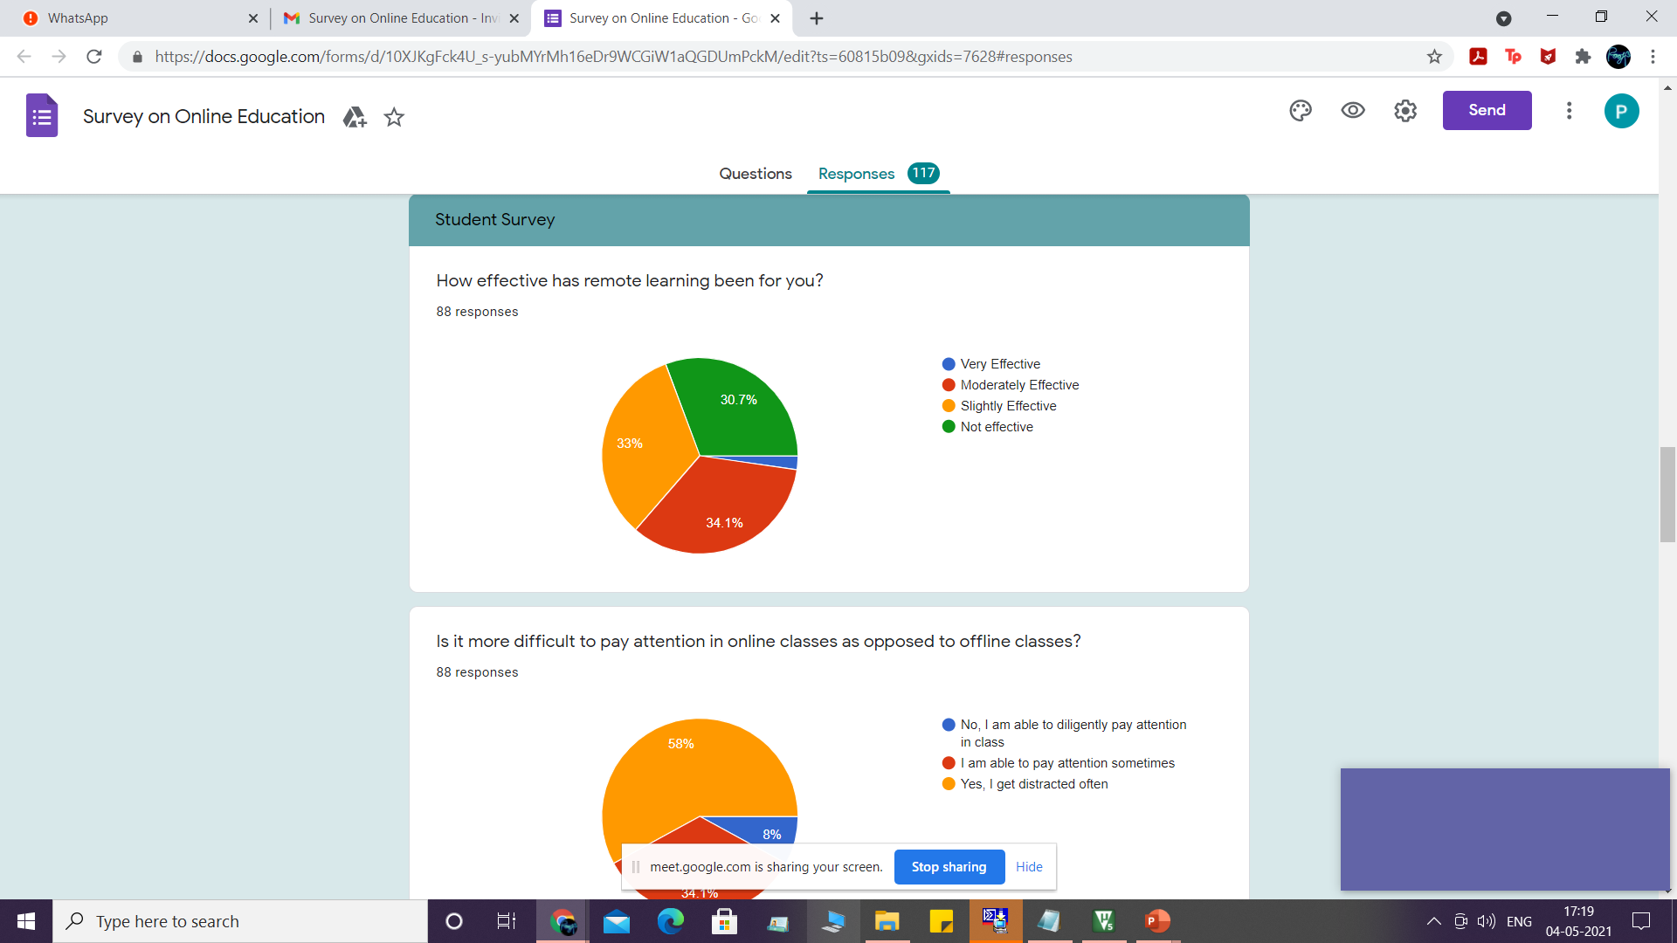
TEACHER VS STUDENT RESPONSES
Go, change the world

Slide 14
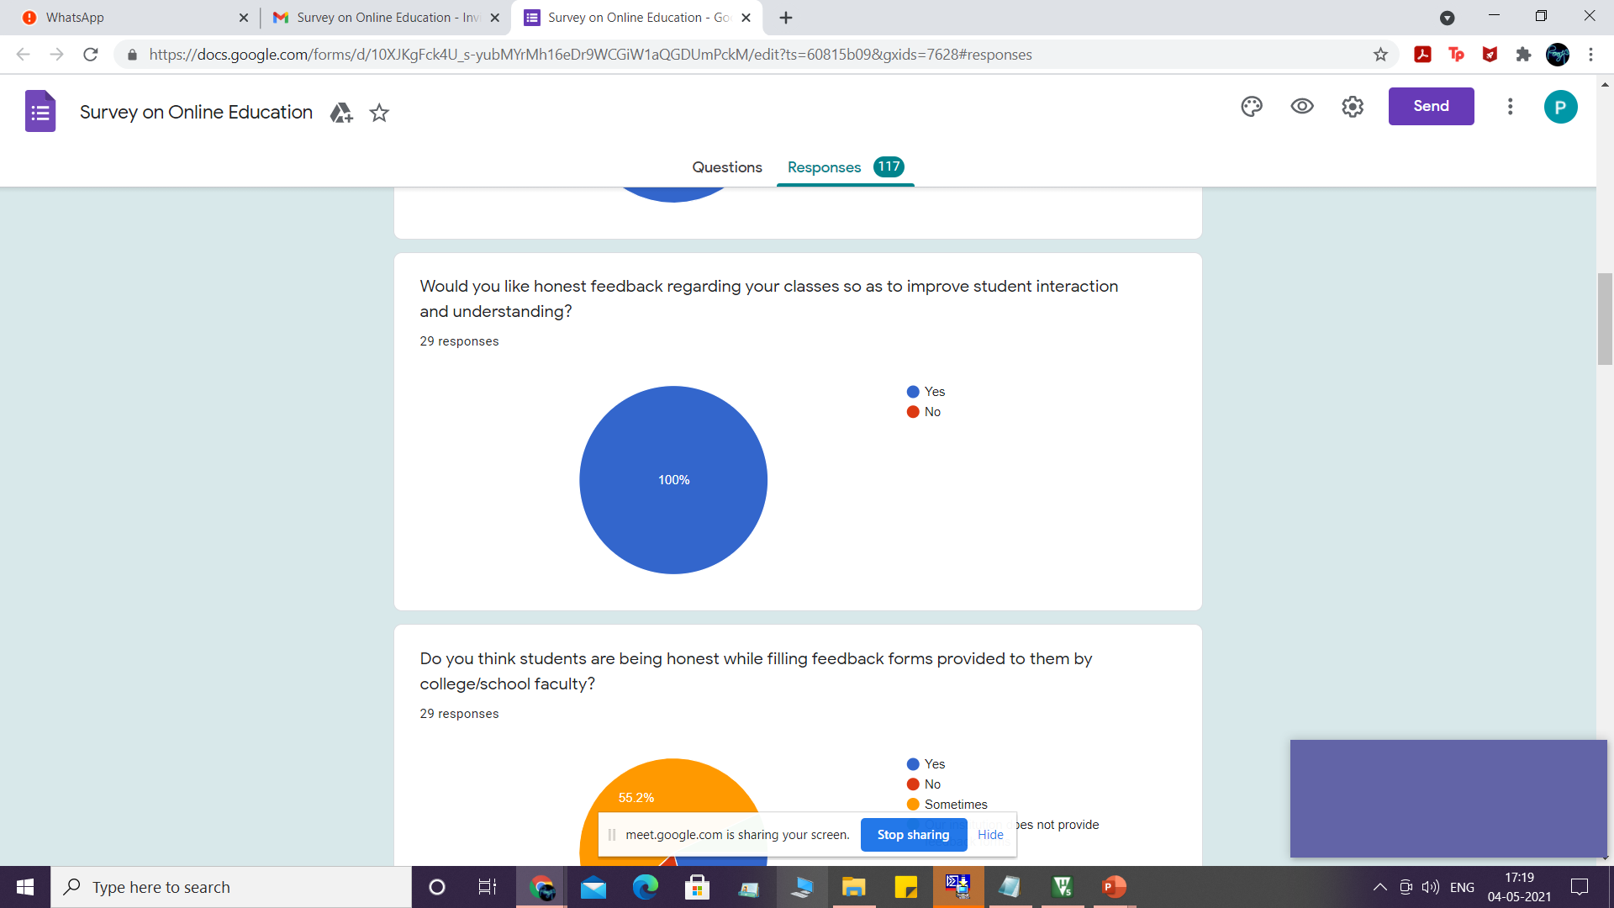
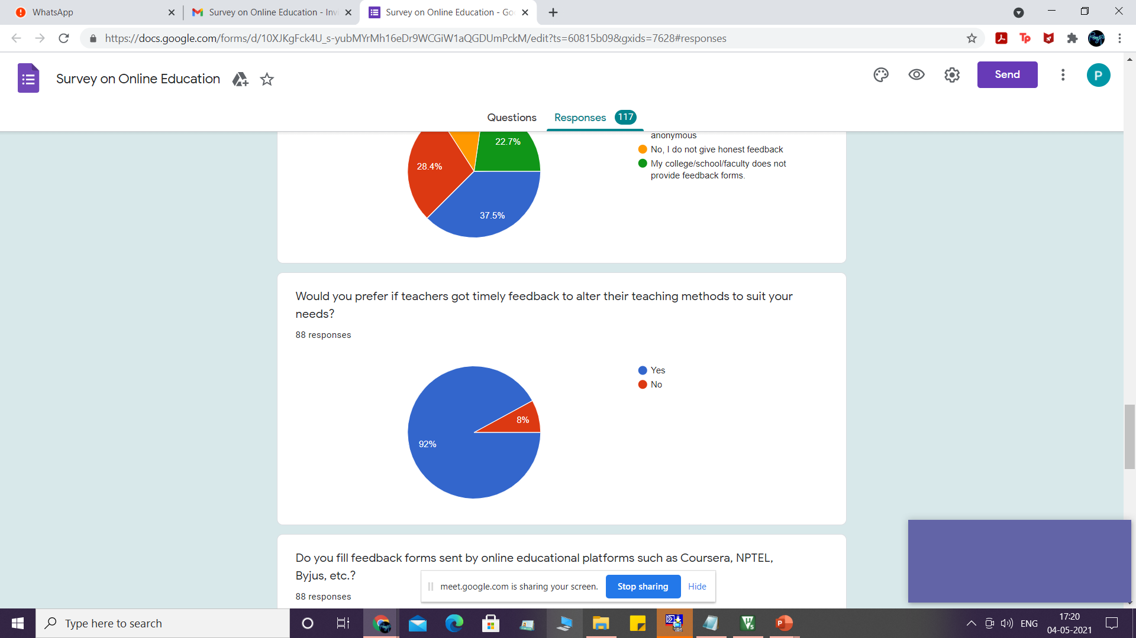
TEACHER VS STUDENT RESPONSES
Go, change the world

Slide 15
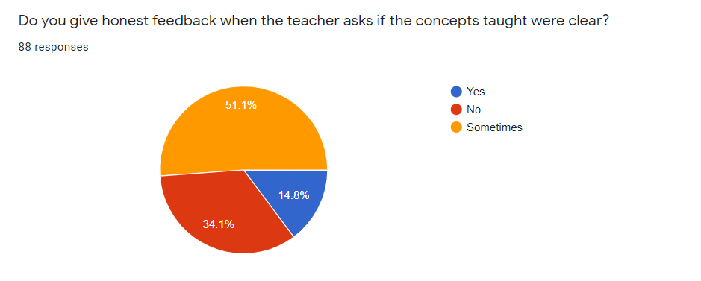
HONESTY IN FEEDBACK
Go, change the world

Slide 16
INFERENCES
Go, change the world
Unresponsive class because students are distracted
Lack of honesty while filling feedback forms
Teachers cannot gauge student understanding
Online education becomes ineffective
Both parties want feedback
But students do not give unbiased feedback

Slide 17

Questionnaire and Interviews
Go, change the world

Slide 18
QUESTIONNAIRE FOR STUDENTS
Go, change the world
As a student attending online classes, how effective has online learning been in comparison to offline classes?
What are some of the difficulties you face while attending online classes?
Do you believe there is an understanding gap between you and the teaching faculty?
Are you able to give timely feedback about what is taught to you?
How honest are you when giving this feedback?
Currently how are you coping with the problems you are facing?
How do you think we can solve this problem in online education?

Slide 19







QUESTIONNAIRE FOR TEACHERS
Go, change the world
As a teacher taking online classes, how effective has online teaching been in comparison to offline classes?
What are some of the difficulties you face while conducting online classes?
Do you believe there is an understanding gap between what is taught by you and what the students grasp?
Are you receiving timely feedback regarding your teaching from students?
How honest do you feel students are when giving feedback?
On what parameters do you assess your children to understand their grasping level (tests, quizzes, verbal affirmation, responsiveness in class, etc)?
Is it difficult to monitor students online while teaching, with the current equipment?
Do you think there is a solution to this problem of monitoring?

Slide 20
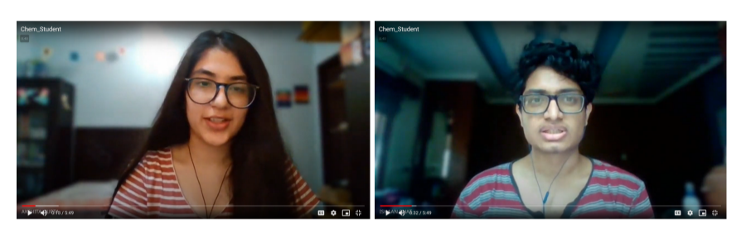
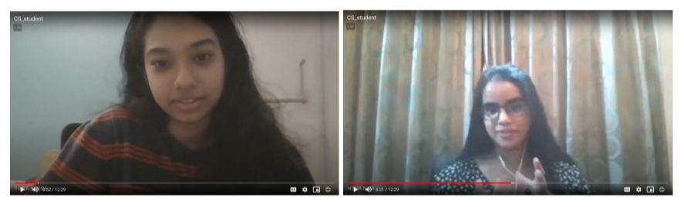
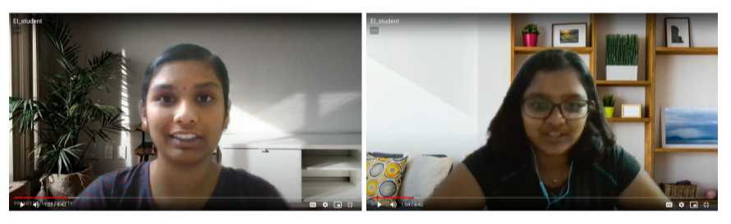
Go, change the world
Interviewing a student from the Chemical Engineering Department
Interviewing a student from the Computer Science and Engineering Department
Interviewing a student from the Electronics and Instrumentation Engineering Department

Slide 21

DRIVE LINK WITH PROOF OF INTERVIEWS
Go, change the world
https://drive.google.com/drive/folders/1KNwMuAZsiyvSp__9tyscGPEkqjXcYnfl?usp=sharing

Slide 22

Empathy Maps
Go, change the world

Slide 23

RVCE STUDENTS
Go, change the world
10 STUDENTS FROM VARIOUS DEPARTMENTS

Slide 24
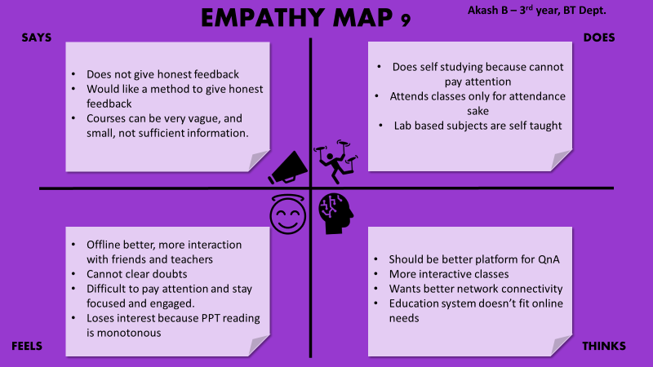
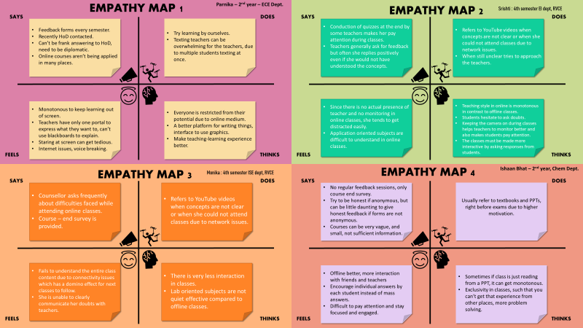
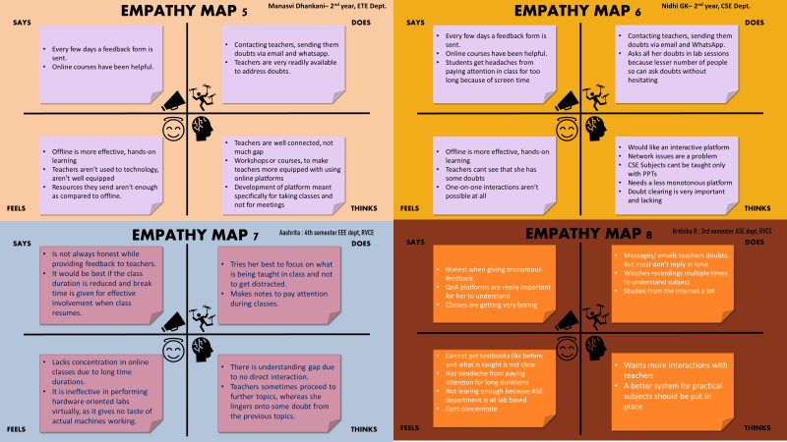
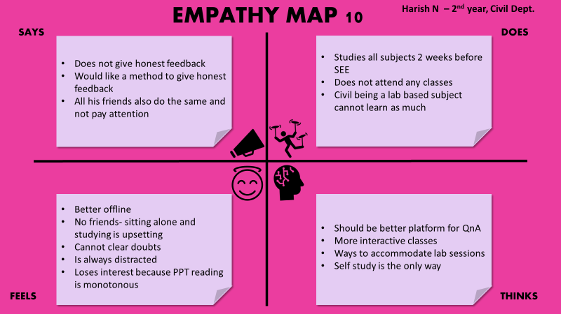
Go, change the world

Slide 25




EMPATHY MAP
RVCE Students
Go, change the world
SAYS
DOES
Course-end surveys are generally provided.
Honest if anonymous feedback.
Not honest when teachers ask about their concept clarity in classes.
Tries to clarify doubts with teachers by messages/emails.
Watches recordings for better understanding.
Refer to textbooks, PPTs sent.
Depend on internet resources (YouTube, etc).
Network issues
Difficult to pay attention and stay focused and engaged.
Offline better, more interaction with friends and teachers.
Unable to learn much in practical oriented subjects.
Need of platform for QnA sessions.
Classes have to be more interactive, with more problem solving, asking responses etc.
Need a less monotonous platform.
Effective doubt clearance techniques needed.
FEELS
THINKS

Slide 26

RVCE TEACHERS
Go, change the world
5 LECTURERS FROM DIFFERENT DEPARTMENTS

Slide 27
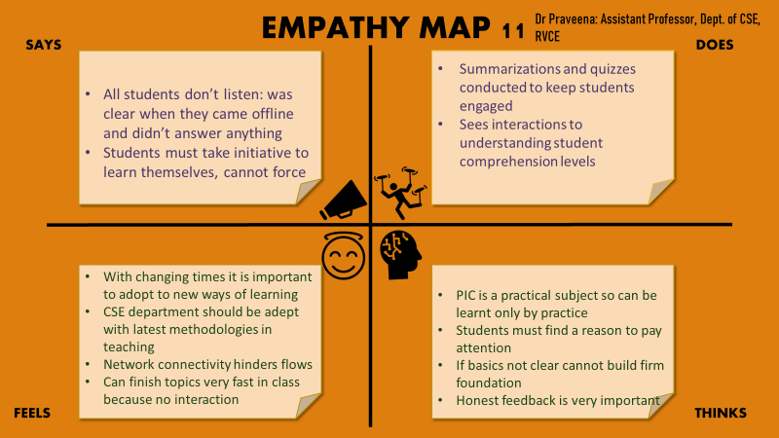
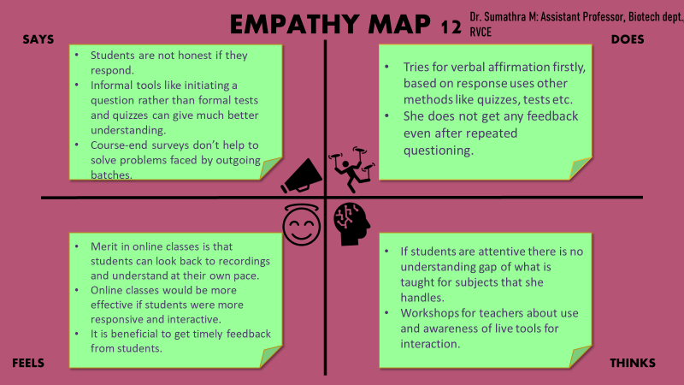
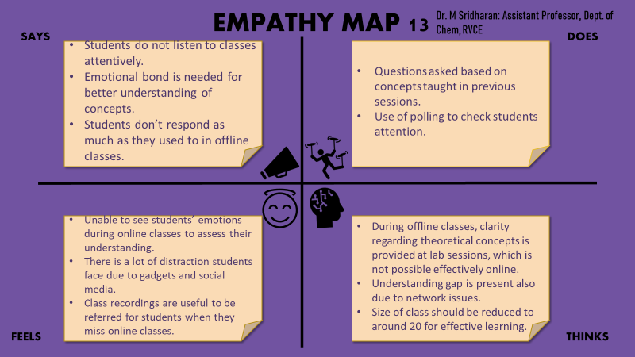
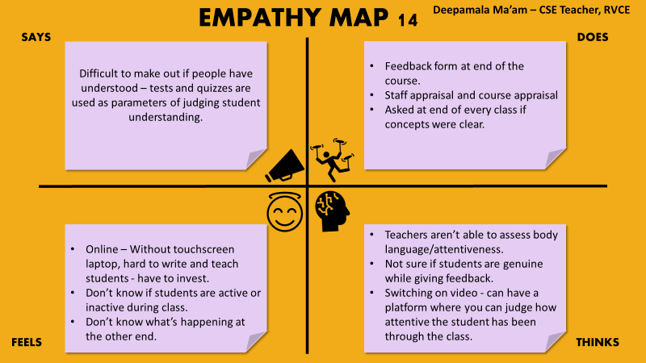

Slide 28
EMPATHY MAP 20
Group Map –Teachers RV
Go, change the world
SAYS
DOES
Students pay attention rarely and it is very difficult to engage them in activities and have them participate willingly
They are also tired of sitting in class and attending online sessions everyday for several hours non stop
I try conducting quizzes, tests and show them YouTube videos to engage them
I try to provide weekly assignments to see if students have the required knowledge
Students tend to get distracted really often
Not same level of education as was on online
Cannot know if student is being honest when giving feedback
Online education needs improvement and must have other interactive tools
Many tools require large investments
Must be a way to successfully interact with students for the benefit of both parties
FEELS
THINKS

Slide 29

STUDENTS IN OTHER EDUCATIONAL FIELDS
Go, change the world
6 STUDENTS FROM OUTSIDE RVCE

Slide 30
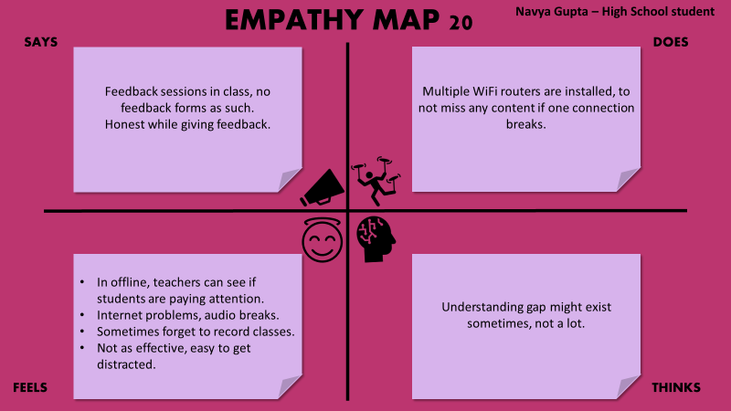
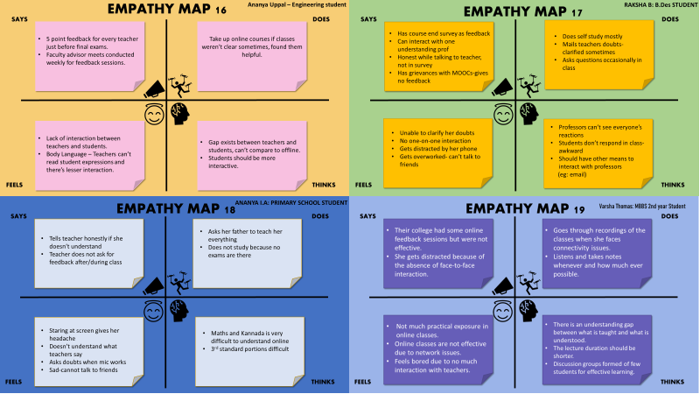
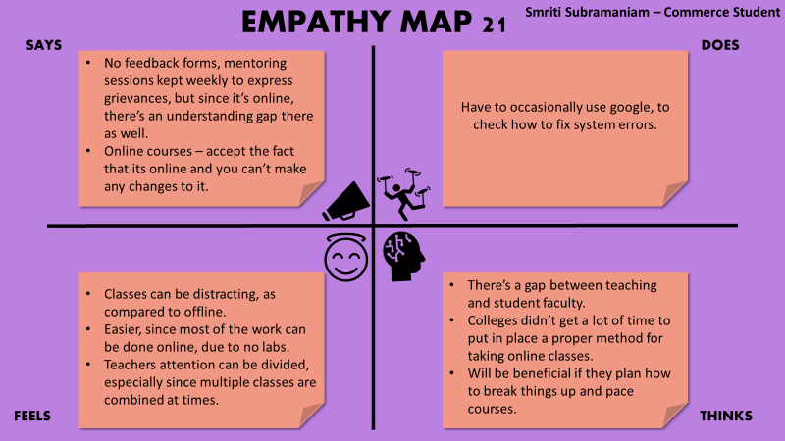

Slide 31
EMPATHY MAP 20
Group Map – Students outside RV
Go, change the world
SAYS
DOES
Most institutions don’t have a survey for feedback and rely on speaking with teachers at the end of classes, or during a feedback session to express grievances.
The level of honesty in the feedback sessions vary, most try to be honest with teachers but don’t fill forms as honestly.
Mostly they resort to self study, and re-watching recordings of classes
Message teachers to get their doubts clarified, ask in class sometimes.
Take up online courses.
Tend to get distracted very often, due to lesser interaction between teachers and students, and the fact that teachers can’t assess body language in online mode.
Difficult to get doubts clarified.
Internet problems.
Practical exposure is lesser
Understanding gap exists between students and teachers.
Classes are monotonous – need to be more interactive.
Keep classes for shorter duration.
Break into discussion groups, and pace courses differently for effective learning
FEELS
THINKS

Slide 32

TEACHERS IN OTHER EDUCATIONAL SECTORS
Go, change the world
4 TEACHERS FROM VARIOUS FIELDS OUTSIDE RVCE

Slide 33
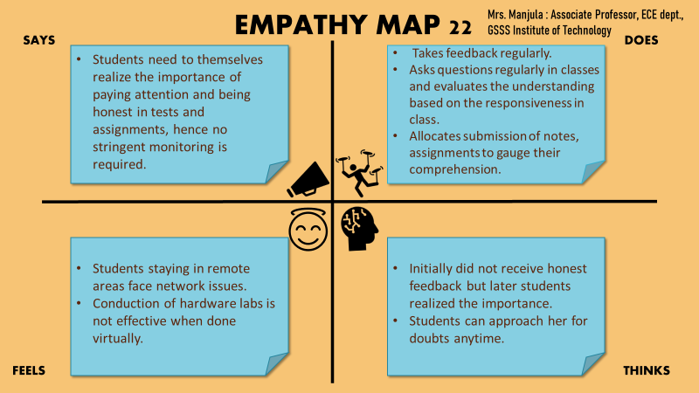
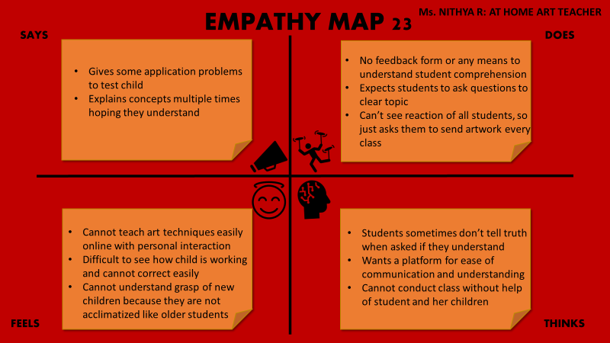
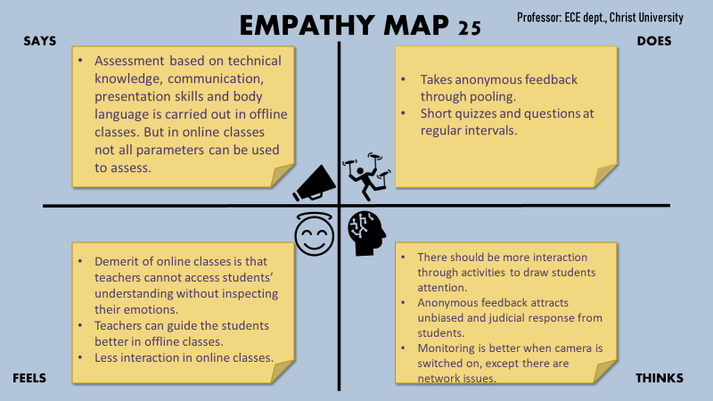
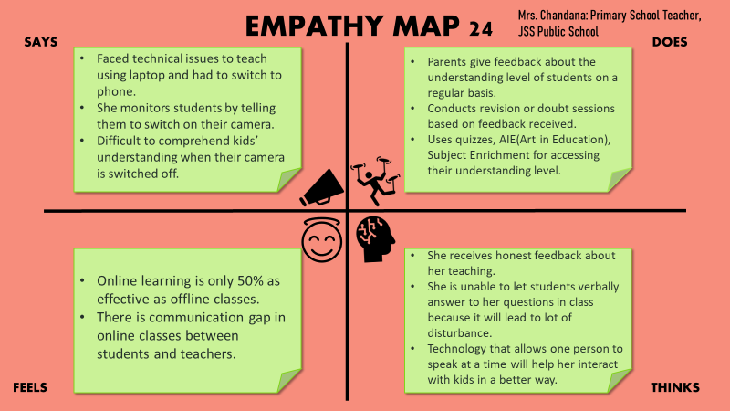

Slide 34
EMPATHY MAP 20
Group Map –Teachers outside RV
Go, change the world
SAYS
DOES
Students have no practical knowledge of the subject being taught, especially in thee online scenario.
The enthusiasm and willingness to learn must come from within and cannot be inculcated.
Asks students to randomly turn on camera and calls out name in class to know if they can answer questions asked
Keeps asking if topics taught are clear
Students have no real world knowledge
They are unaware of what the subject actually means
No way to know if honest feedback is being given until exam results
There must be a better system in place to test students and prepare them for the real world through online mechanisms
Problems like internet connectivity and lack of tools must not become a hindrance to deliver knowledge.
FEELS
THINKS

Slide 35
PROBLEMS IDENTIFIED FROM EMPATHY MAP
Go, change the world
TEACHERS
STUDENTS
Too many distractions
Network issues
Teachers cant tell if student is finding difficulty
No one-to-one interaction
Monotonous classes and lose interest
Headache
Screen time very high
Cant pay attention for such a long duration
Writing of teachers unclear
No practical experience
Messaging not as effective for doubts
Network issues
No engagement
Poor interaction
Body language assessment difficult
Not genuine while giving feedback
No touchscreen laptop
Difficult to monitor every student
Low attendance

Slide 36
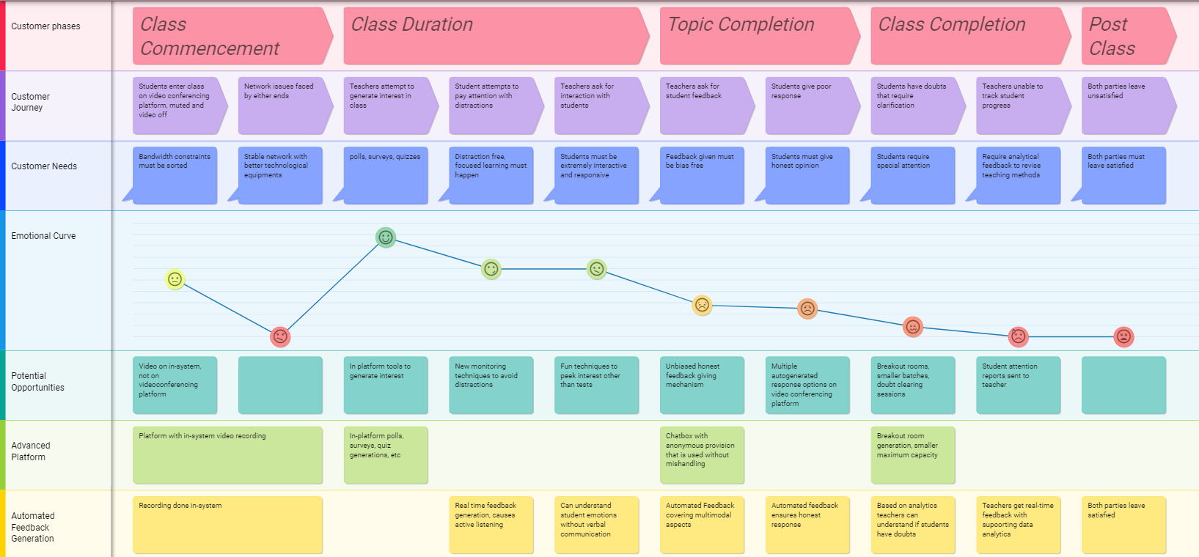
Customer Journey Map
Go, change the world
https://custellence.com/app/public/47047740

Slide 37

REFERENCES FOR EMPATHY PHASE
[1]https://www.interaction-design.org/literature/topics/empathize#:~:text=Empathize%20is%20the%20first%20stage,'%20experiences%2C%20motivations%20and%20problems.
[2] https://www.interaction-design.org/literature/article/design-thinking-getting-started-with-empathy
[3] https://www.interaction-design.org/literature/topics/empathize
[4] Perspective and Use of Empathy in Design Thinking Andrea Gasparini
[5] https://www.qed42.com/blog/how-empathy-works-in-design-thinking
[6] Köppen E., Meinel C. (2015) Empathy via Design Thinking: Creation of Sense and Knowledge. In: Plattner H., Meinel C., Leifer L. (eds) Design Thinking Research. Understanding Innovation. Springer, Cham. https://doi.org/10.1007/978-3-319-06823-7_2

Slide 38

PROBLEM DEFINITION
Go, change the world

Slide 39
Go, change the world
POV
Students and teachers need a way to make sessions more interactive and responsive because the lack of honest feedback results in lower educational quality

Slide 40
HOW MIGHT WE?
Go, change the world
How might we generate honest and unbiased feedback from student?
How might we make classes more interactive?
How might we create real-time changes when topics are not clear to students?
How might we ensure students are able to timely seek help?
How might we ease the burden of teachers in helping students comprehend?
How might we help teachers gauge student understanding levels?

Slide 41

PHASE 2
Go, change the world
IDEATION

Slide 42





PROCESS
82 IDEAS GENERATED +SEGREGATED
SCAMPER
BRAINSTORM CLOUD
WORST POSSIBLE IDEAS
MIND MAP
STORY BOARD

Slide 43
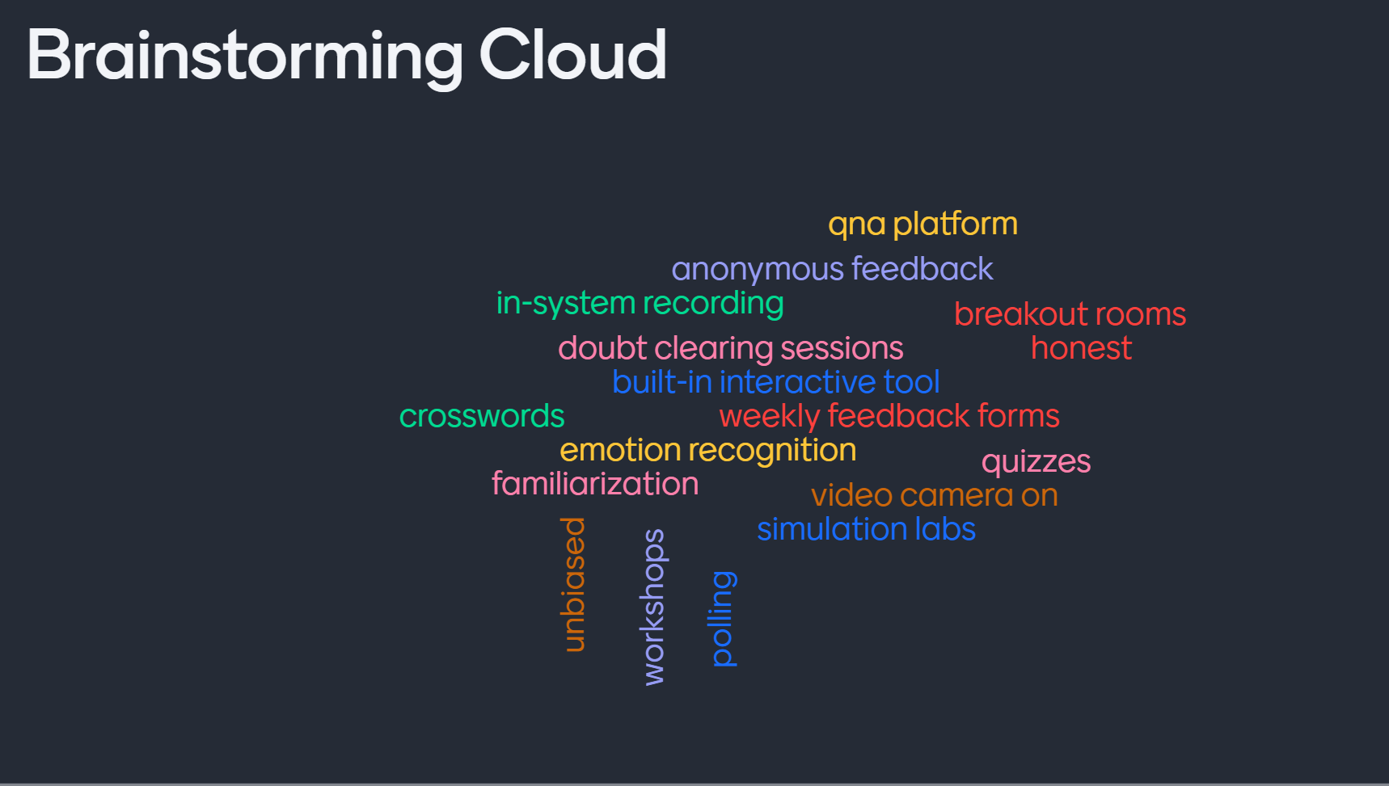
Go, change the world

Slide 44
WORST POSSIBLE IDEAS
Go, change the world
Making teachers go through each students' recordings
Telephone call to each student to ask for feedback
Keeping test everyday after class with weightage
Homework everyday
Have teachers teach small batches (10-students)
Individual Doubt clearing sessions for each student

Slide 45







Rotational Equipment
Go, change the world
MIND MAP
Simulation Labs
No Practical Labs
Poor Response
Video Demonstration
Organized Recordings
Interactive Tools
Network Issues
Distracted Students
In-System Recordings
Real Time Analysis
QnA Platforms
Uncleared Doubts
Dishonest Feedback
Emotion Recognition
Breakout Rooms
Pie Charts and Graphs Analysis
Dedicated Doubt Clearing Threads

Slide 46







SCAMPER
Go, change the world
Substitute
Combine
Adapt
Maximize
Or Minimize
Put to other use
Eliminate
Reverse
Google forms,
Polling sites, quizzes, word cloud
Group sentimental analysis with suggested polls/quizzes, etc
Adapting to covid crisis
Maximize student understanding while minimizing doubts
Business presentation trainees and MOOCs
Solutions for network instability and new platform creation
Reversing feedback generation

Slide 47
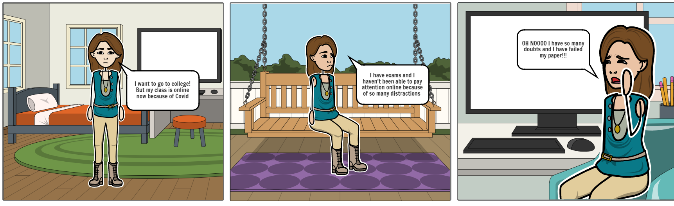
STORYBOARD
Go, change the world
STUDENTS BEFORE

Slide 48
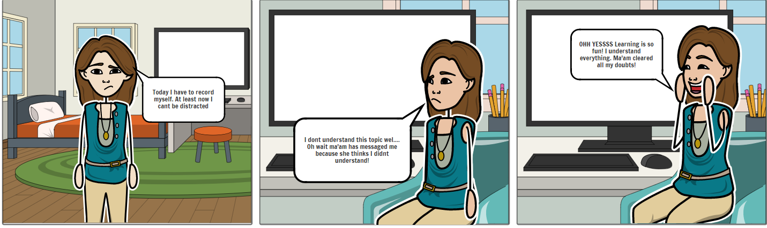
Go, change the world
STUDENTS AFTER

Slide 49
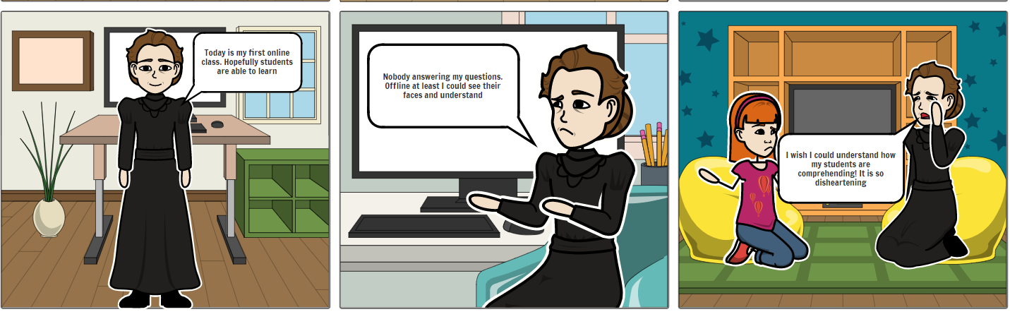
Go, change the world
TEACHERS BEFORE

Slide 50
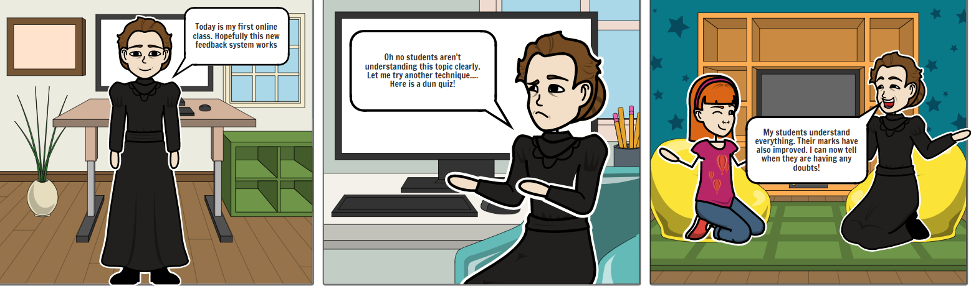
Go, change the world
TEACHERS AFTER

Slide 51
IDEA GENERATION
Go, change the world
1 Workshop for teachers.-simplify 2 Doubt clearance sessions once in a month.-me too 3 Breakout room forum.-virtualize 4 Weekly teacher student meetings.- me too 5 Industry expert sessions.-virtualize 6 Daily homework without weightage.-remix 7 Group discussions.-remix 8 Well organized class recordings.-simplify 9 Allow students to choose time table.-almost impossible 10 Homework assignments weekly instead of quizzes.-remix 11 Online parent teachers meeting.-virtualize 12 Allow credits from outside college.-me too 13 Try not to extend the semester and figure out way to have online SEE so semester can end soon.-Almost Impossible 14 Use of animated videos and interactive simulations.-virtualize 15 More open book tests to test application, unlike rote learning in closed book.-remix

Slide 52
Go, change the world
16 2 min breaks every 30 minutes.-simplify 17 Tool oriented video conferencing platform.-remix 18 Non mandatory attendance to generate self interest.-almost impossible 19 Have debate sessions in class to learn latest technology and buzz words in each topic.-remix 20 Grading as a mix of baseline absolute and relative grading.-remix 21 YouTube channel by professors.-me too 22 Provision of sufficient transition time.-simplify 23 Not waste time in taking attendance by calling out names.-simplify 24 Devices and tools on rent for at home practicals.-almost impossible 25 Multiple redemption options in tests.-almost impossible 26 Well organized class reference material.-simplify 27 No lab marks every week so students can focus on understanding practicals more than worrying about marks.-simplify 28 Self paced prerecorded course content.-virtualize 29 Allow dropping courses of less interest.-almost impossible 30 Automated feedback generation.-virtualize

Slide 53
Go, change the world
31 Not have 20 minute quizzes that have too many calculations to reduce student pressure.-simplify 32 Encourage more friendly competitions and participation in competitions.-me too 33 Best of multiple tests.- me too 34 Efficient platform for assignment submission.- remix 35 Student body council.- me too 36 Decide if semester is completely online/offline so students don't have to oscillate between rote learning and application based learning.- simplify 37 Aim of lab sessions to be expanded to imparting practical knowledge and skills rather than mere completion of a set of experiments.-virtualize 38 Lecturers can explain their research work and accomplishments in weekly sessions to motivate students to learn more about the topic.-virtualize 39 Have meetings with students where they can come up with innovative ideas to solve the problems they face in college life and try said solutions for a short duration.-simplify 40 Multiple teachers taking class together so can focus on teaching and students.-Almost Impossible 41 Add a grade for participating in fest events related to stream.-Almost Impossible 42 Organize department wise fests with extra credit for organizing events.-Almost Impossible 43 Taking attendance more than once.-simplify 44 Fun activities like word puzzles, crosswords, hangman etc.-remix 45 Office hours like in Abroad universities.-me too

Slide 54
Go, change the world
46 Course content given in a single pdf for each unit, instead of multiple ppts and files.-simplify 47 Have alternate plans instead of NPTEL courses for students who cannot leave their houses in lockdown due to immunocompromised family members.-virtualize 48 Longer theory sessions and fewer classes throughout week.-virtualize 49 Daily anonymous feedback form.-me too 50 QnA platform.-remix 51 Brainstorming sessions.-virtualize 52 Digital discrepancy box.-remix 53 Daily quizzes with weightage.-remix 54 Peer evaluation of assignments.- me too 55 Games and Activities to generate interest.-remix 56 Topic presentation by students.-remix 57 In system video recording.-virtualize 58 Have higher semester student mentors and Teaching Assistance from them.-simplify 59 Hardware lab video recordings. -virtualize 60 More practice assignments for test preparation.-simplify

Slide 55
Go, change the world
61 Flipped classroom sessions.-remix 62 Student teacher fun activities to increase bonding.-me too 63 Not 9-5 but less rigid timetable timings.- simplify 64 Online ethnic day and 8th mile to generate interest in college.-Almost Impossible 65 Mail content to students who have poor network.-Almost Impossible 66 Basing attendance on response during class.-me too 67 Not relying on entire MOOC courses for self study component and having more projects.-remix 68 Follow semester calendar and intimate students regarding tests well in advance instead of 2-3 days prior.-simplify 69 Have a better platform that has good performance than quiklrn so students don't have to worry about autosubmission or uploading answer scripts problem.-virtualize 70 If a teacher is absent, try to avoid double class of same subject as a substitute.-simplify 71 More elective courses to change course of focus.- me too 72 Interactive simulation labs.-Virtualize 73 Fundraiser for blackboards in all teacher’s homes.-Almost Impossible 74 Alarm system on class duration completion to avoid spilling of classes into break time -Simplify 75 Instead of writing in data sheets, allowing students to execute lab programs immediately.-Simplify

Slide 56
Go, change the world
76 Ensure that regular breaks are actually given, and not taken up by other activities.-Simplify 77 Mental heath holidays.-Almost impossible 78 In-class Competitions to encourage active learning.-Me too 79 Familiarization of online environment.-Virtualize 80 Testing should allow 1-2 quick notes because not everything needs to be mugged up in real life too.-Me too 81 Remove redundant work like record writing or hand-written notes so students have more time to study.-Simplify 82 Affect recognition.-Virtualize

Slide 57
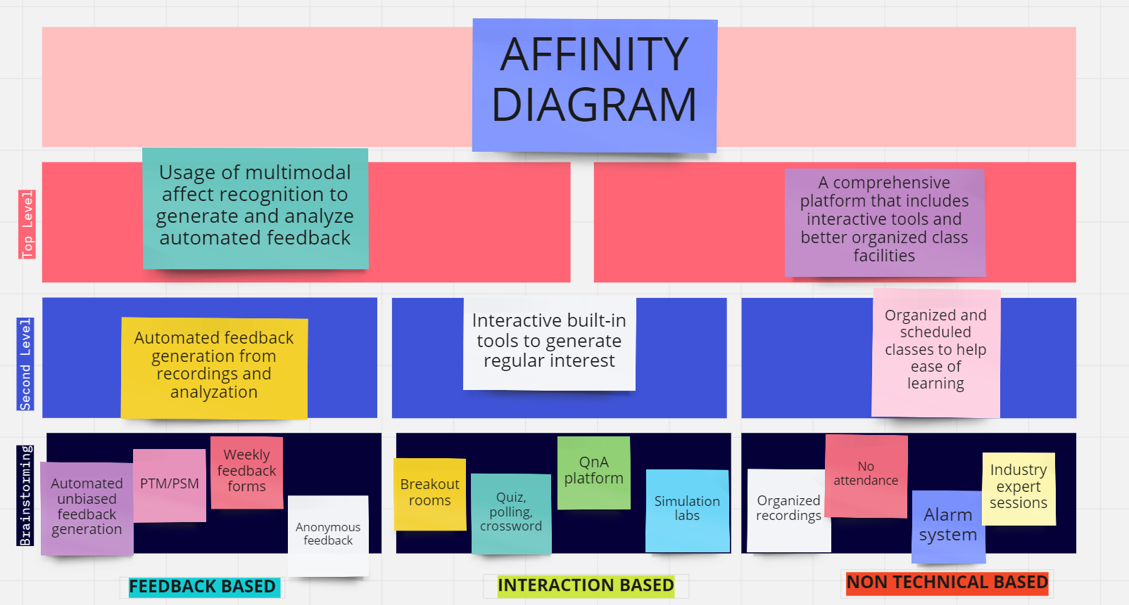

Slide 58


COMPARISON
FEATURES | Previously existing model | Our Model
Breakout Rooms
Polling, Quizzes, etc.
Private Chat
Record Meetings
Posture and Emotion Recognition
Eye Tracking
Pie charts, graphs, dashboard of analysis
Real-time data
Feedback Generation

Slide 59
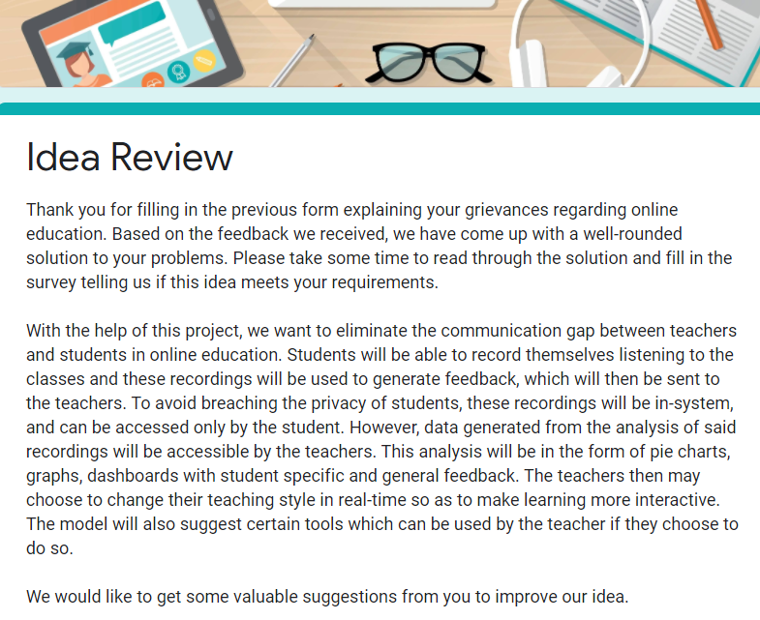

Slide 60
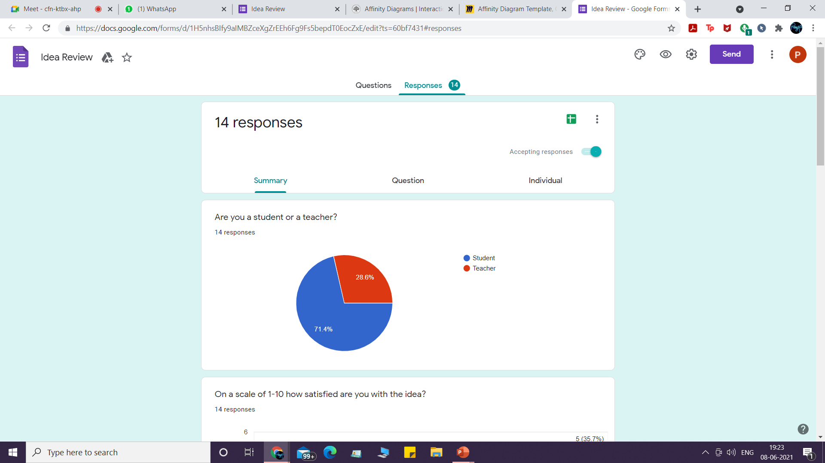
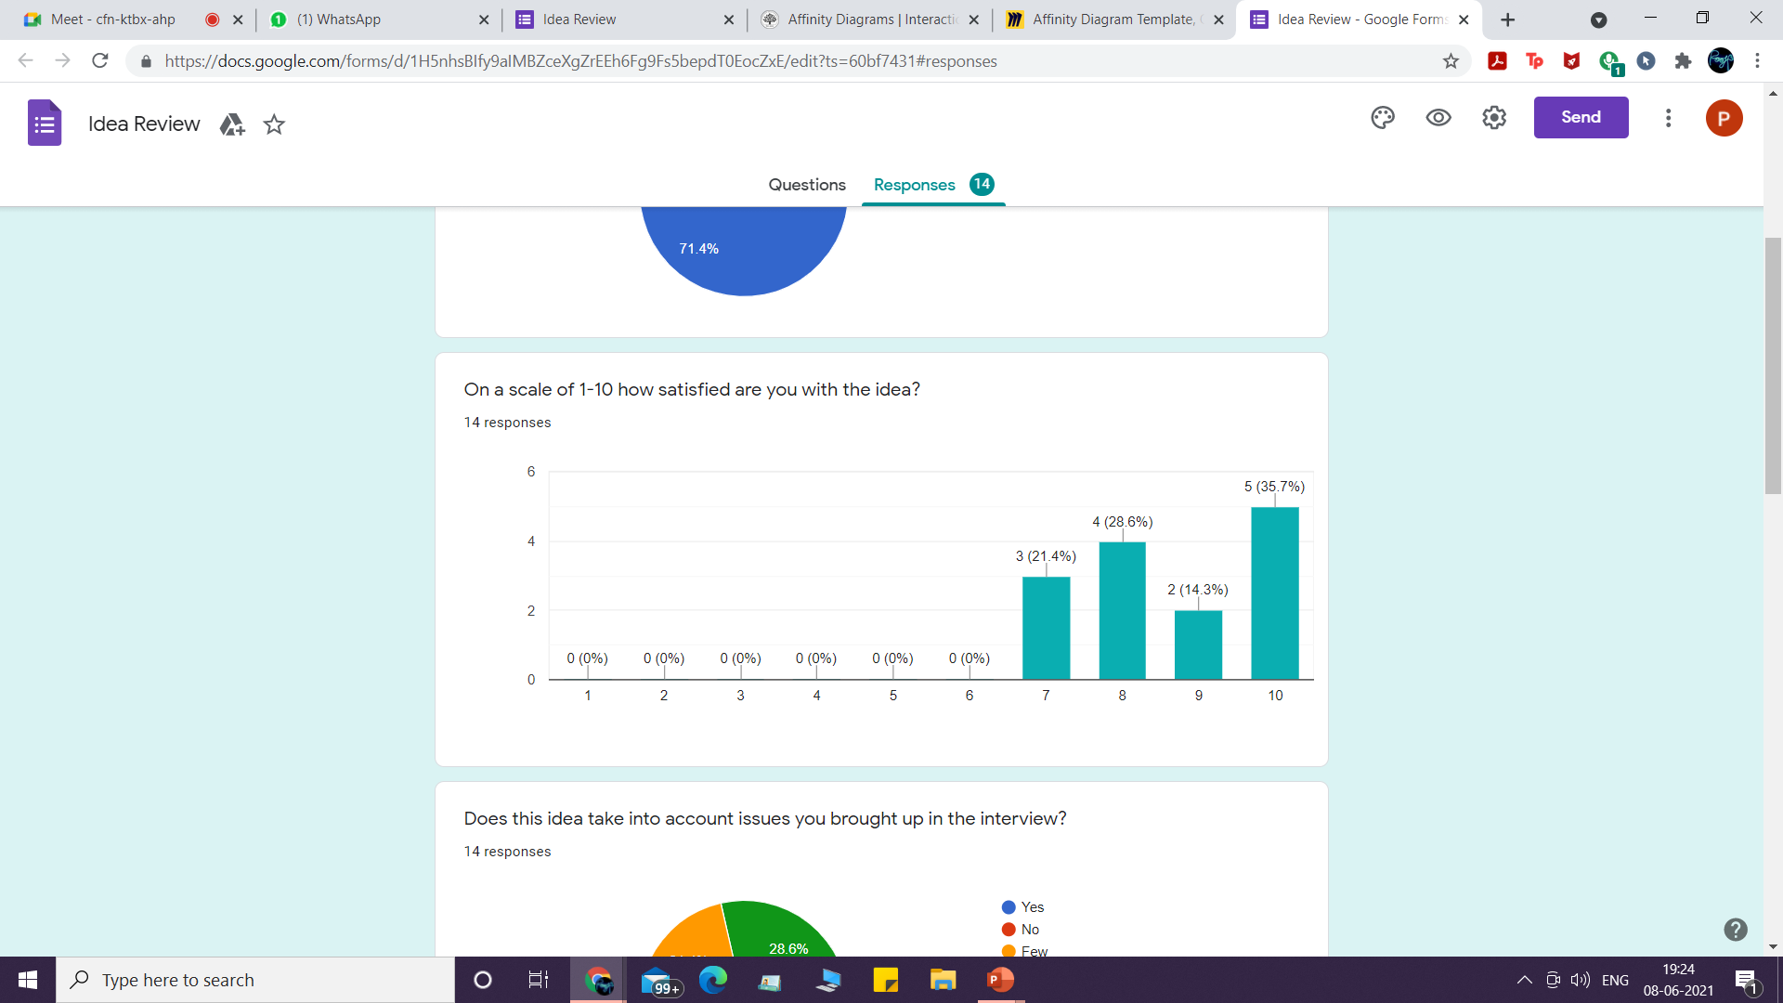
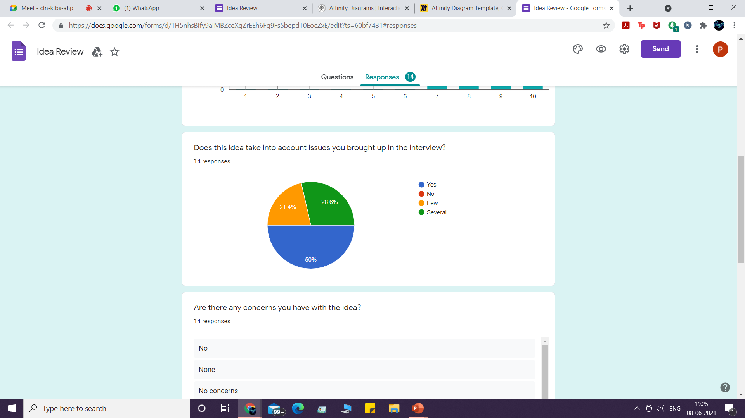
STAKEHOLDER REVIEW

Slide 61

UPDATED REVIEW

Slide 62
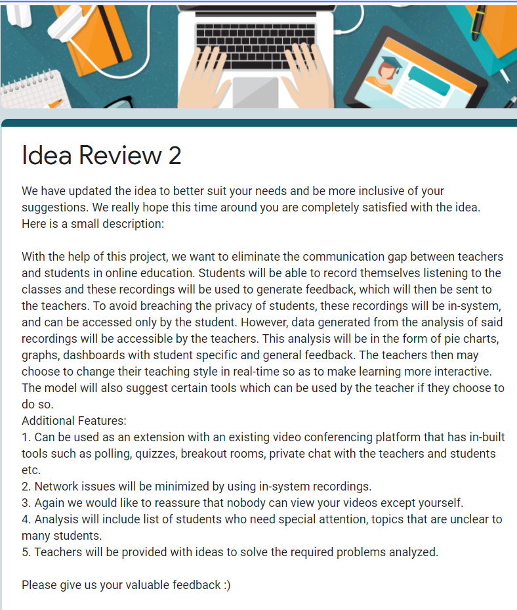

Slide 63

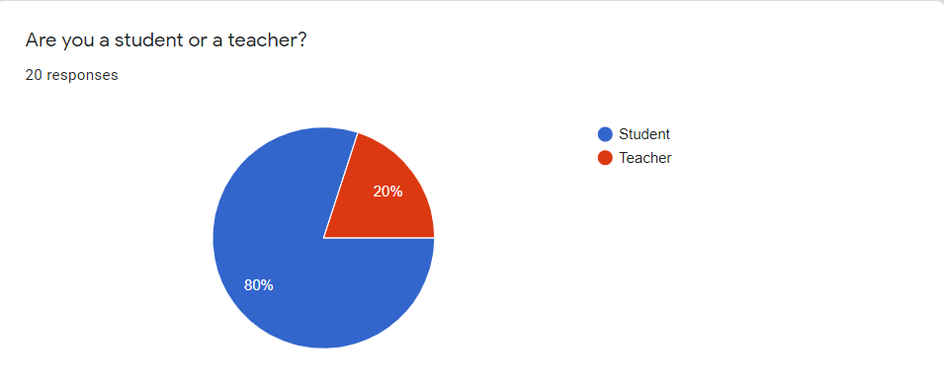
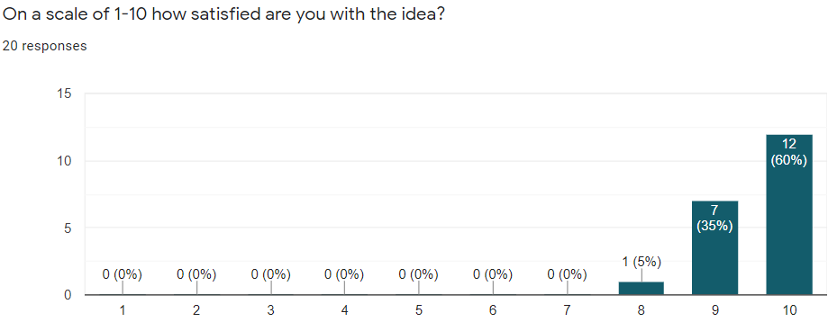
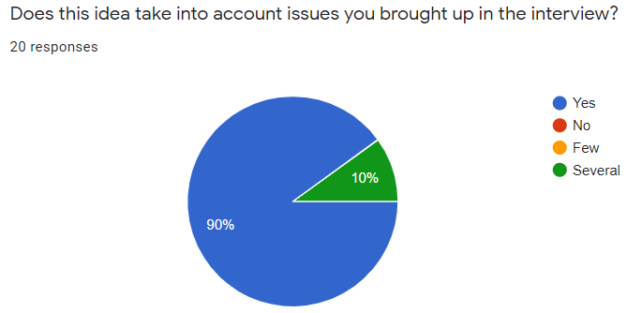

Slide 64
REFERENCES FOR IDEATION PHASE
[1] Design ideation: the conceptual sketch in the digital age Author links open overlay panelBenJonson
[2] Design Thinking for Innovation. Stress Testing Human Factors in Ideation Sessions John Knight, Dan Fitton, Charlie Phillips & Dylan Price
[3] https://www.interaction-design.org/literature/topics/ideation#:~:text=Ideation%20is%20a%20creative%20process,facilitated%2C%20judgment%2Dfree%20environment.
[4] https://careerfoundry.com/en/blog/ux-design/what-is-ideation-in-design-thinking/
[5] https://www.uxpin.com/studio/blog/design-thinking-ideation/
[6] https://www.interaction-design.org/literature/article/stage-3-in-the-design-thinking-process-ideate

Slide 65

PROTOTYPE
PHASE 3

Slide 66
Steps of Prototyping Phase
1
2
3
4
5
Low Fidelity Prototype
Prototype Design
Model building
User Input
High fidelity Prototype

Slide 67



LOW FIDELITY PROTOTYPE
WIZARD OF OZ PROTOTYPE
BROUGHT IN 2 USERS TO TEST OUR LOW FIDELITY-MOCK WEBSITE
RECEIVED FEEDBACK TO WORK ON HIGHER PROTOTYPE

Slide 68
Analysis, QnA, Timetable, Quizzes and Tests
Analysis:
Pie Charts, Graphs
QnA:
Answered, post questions
Quizzes and Tests:
Score Analysis
Timetable:
Class, subject, date, time, link
Dashboard:
Student
Register
Or
Login
Login as student or teacher
Video Recording + interactive tools
PROTOTYPE DESIGN
https://ar-online-education.godaddysites.com/
Teacher
Analysis, QnA, Schedule, Quizzes and Tests
Dashboard:
Analysis:
(student and class wise)
QnA:
Answered,Unanswered post questions
Quizzes and Tests:
Correct and score
Timetable:
Class, subject, date, time, link

Slide 69

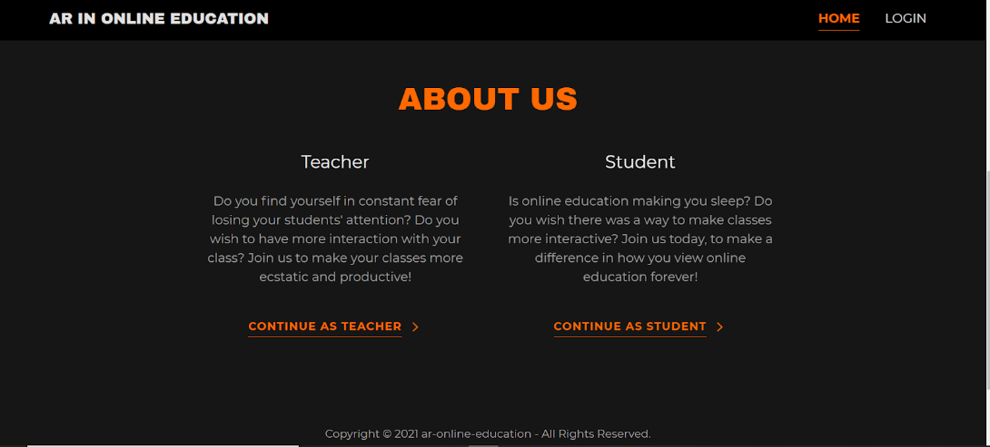
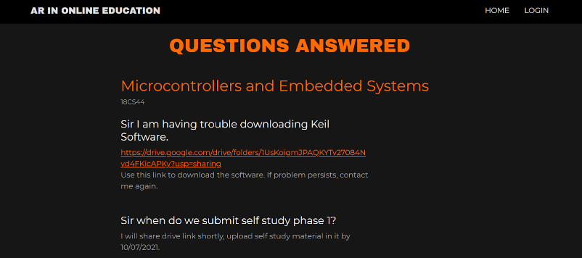
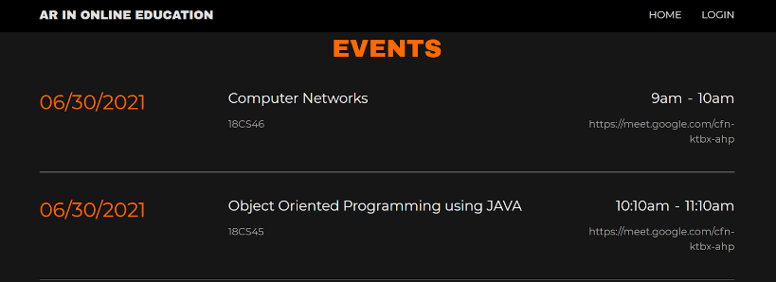



Slide 70






STUDENT USER
Related answered Questions must be shown (like a discussion forum)
Gives attendance details on timetable automatically
Arrange feedback in analysis from poor to high
Needs a description of what the platform does
Hover on dashboard icons to learn about each feature

Slide 71

TEACHER USER
01
02
03
04
Give student details when question asked, apart from just name
Don’t allow students to ask repeated questions
Give option reschedule/ see other day’s schedule
Give combined data of all students to see how I perform as a teacher

Slide 72




OBJECTIVES
To develop and train deep learning models in affect recognition.
To assimilate the data procured from the model to give teacher feedback and student analysis
To contrast student perception with teacher teaching
To categorise student emotions

Slide 73



METHODOLOGY
Emotions: bored, neutral, interested, confused, distracted, frustrated
Classification or Regression model
Monitoring parameters are eye-tracking, verbal speech recognition, face tracking of video, posture and gesture recognition.

Slide 74

CONVOLUTION NEURAL NETWORK (CNN)
For gesture/posture recognition

Slide 75


SUPPORT VECTOR MACHINE (SVM)
FOR SPEECH EMOTION RECOGNITION AND FACE/EYE MOVEMENT
MULTI CLASS CLASSIFICATION

Slide 76





TECHNIQUES OF ANALYSIS
Emotions
Pie chart and graphs
Feedback
Attention Levels
Eye Tracking

Slide 77




HIGH FIDELITY PROTOTYPE
file:///D:/interships_projects/affect_recognition/Emotion_Detection_CNN-main/Prototype/Home.html
CNN MODEL TRAINED ON
FER 2013 DATASET
REAL TIME IN-SYSTEM VIDEO CAPTURE USING OPEN CV
GENERATION OF REAL TIME FEEDBACK THROUGH GRAPHS
WEB INTERFACE FOR STAKEHOLDERS TO GET FEEDBACK IN REAL TIME

Slide 78






Slide 79





Slide 80
REFERENCES FOR PROTOTYPE PHASE
[1] https://www.interaction-design.org/literature/article/design-thinking-get-started-with-prototyping#:~:text=A%20prototype%20is%20a%20simple,or%20possible%20changes%20in%20direction.
[2] https://www.interaction-design.org/literature/article/stage-4-in-the-design-thinking-process-prototype
[3] https://careerfoundry.com/en/blog/ux-design/design-thinking-stage-four-prototyping/
[4] https://library.parenthelp.eu/wp-content/uploads/2021/03/www.interaction-design.org_.pdf
[5] Ashish Kapoor and Rosalind W. Picard, Multimodal Affect Recognition in Learning Environments, MIT Media Laboratory, Cambridge, MA 02139, USA
[6] Krithika L.B, Lakshmi Priya GG, Student Emotion Recognition System (SERS) for e-learning improvement based on learner concentration metric, School of Information Technology and Engineering, VIT University, Vellore,632014, India

Slide 81







LEARNINGS OF DESIGN THINKING
CREATIVE THINKING
METHODICAL APPROACH
EMPATHIZING
CONFIDENCE
PATIENCE
ENDURANCE
TEAMWORK
RESEARCH ABILITIES
PROOF OF CONCEPT

Slide 82
REFERENCES
[1] 5 Stages in the Design Thinking Process by Rikke Friis Dam and Teo Yu Siang, Interaction Design Foundation.
[2] Design Thinking: Getting Started with Empathy by Rikke Friis Dam and Teo Yu Siang, Interaction Design Foundation.
[3] Stage 1 in the Design Thinking Process: Empathise with Your Users by Ditte Hvas Mortensen.
[4] Stage 3 in the Design Thinking Process: Ideate by Rikke Friis Dam and Teo Yu Siang, Interaction Design Foundation.
[5] Stage 4 in the Design Thinking Process: Prototype by Rikke Friis Dam and Teo Yu Siang
[6] Ashish Kapoor and Rosalind W. Picard, Multimodal Affect Recognition in Learning Environments, MIT Media Laboratory, Cambridge, MA 02139, USA
[7] Krithika L.B, Lakshmi Priya GG, Student Emotion Recognition System (SERS) for e-learning improvement based on learner concentration metric, School of Information Technology and Engineering, VIT University, Vellore,632014, India
[8] https://files.eric.ed.gov/fulltext/EJ1287167.pdf

Slide 83
Thank You ☺

